Slide 1
Your Idea is dangerous and must be crushed
The ramblings of an acolyte Product Owner

Slide 2

About Me - Steve Pitchford
Certified CSPO in 2014
Software Developer for > 20 years
Currently “Development Manager” at http://majestic.com
Former Technical Architect, Jungle.com
Tendency to sit on “Agile Boundary”

Slide 3
Agile - A quick visit
An umbrella - not a methodology
Fix for term “lightweight methodologies”
Attempts to address difficulties with up-front design and excessive attempts at control

Slide 4
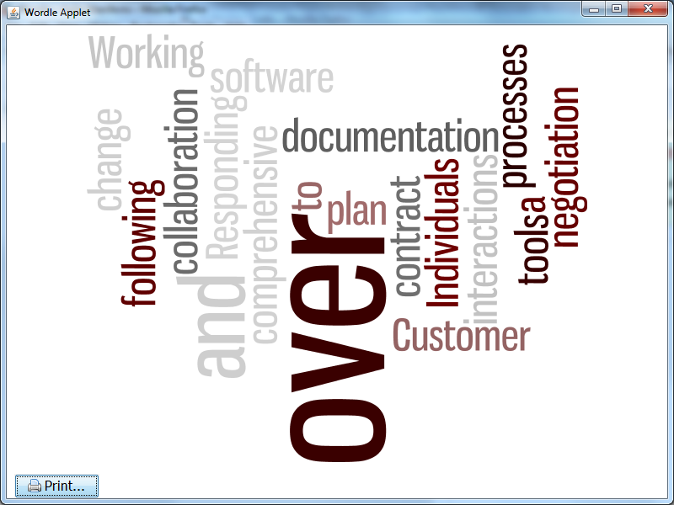
Before we begin, after we have begun
http://www.wordle.net/show/wrdl/8274942/Agile_Manifesto

Slide 5
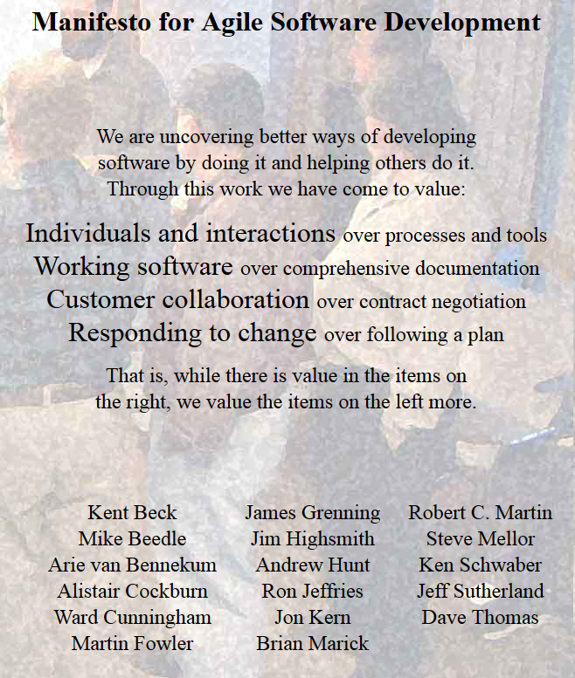
Agile Manifesto

Slide 6
The “Agile Boundary”
What
How

Slide 7
The “Agile Boundary” - Scrum
Product Owner
Scrum Master

Slide 8
Definitions...
The Scrum Master… Isn’t a master… The Product Owner… Isn’t an owner...

Slide 9
The world of the product owner

Slide 10
The “What Gang”
Customers

Slide 11
The “What Gang”
Customers
Market

Slide 12
The “What Gang”
Customers
Market
Stakeholders:
Management
Developers
Marketing
Sales
...

Slide 13
The Result...
💡💡💡💡💡💡💡💡💡💡💡💡💡💡💡💡💡💡💡💡💡💡💡💡💡💡💡💡💡💡💡💡💡💡💡💡💡💡💡💡💡💡💡💡💡💡💡💡💡💡💡💡💡💡💡💡💡💡💡💡💡💡💡💡💡💡💡💡💡💡💡💡💡💡💡💡💡💡💡💡💡💡💡💡💡💡💡💡💡💡💡💡💡💡💡💡💡💡💡💡💡💡💡💡💡
Too many ideas…
💡💡💡💡💡💡💡💡💡💡💡💡💡💡💡💡💡💡💡💡💡💡💡💡💡💡💡💡💡💡💡💡💡💡💡💡💡💡💡💡💡💡💡💡💡💡💡💡💡💡💡💡💡💡💡💡💡💡💡💡💡💡💡💡💡💡💡💡💡💡💡💡💡💡💡💡💡💡

Slide 14
Talk not about prioritising ideas
Instead, see:
Kano Analysis
Lean Startup
Product Vision / Go Roadmap
ROI - Effort / Return ...

Slide 15

Talk is about Ideas
src: http://www.wpclipart.com/cartoon/animals/germ/virus_cartoon.png.html

Slide 16
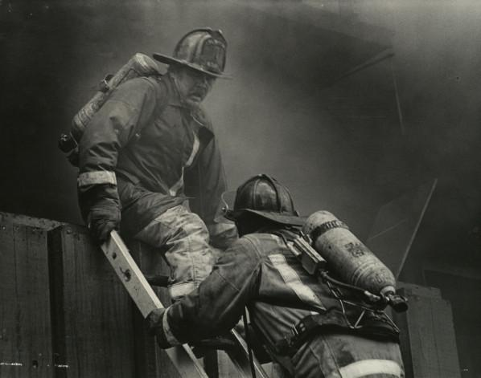
And Danger
src: http://commons.wikimedia.org/wiki/File:3_Alarm_Building_Fire.jpg

Slide 17
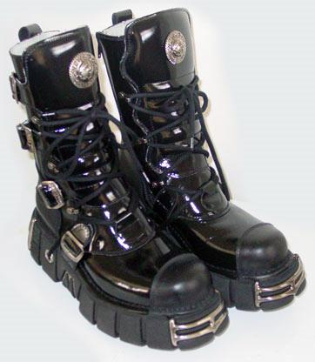
And Crushing
⇓
src: http://commons.wikimedia.org/wiki/File:New-Rock-boots.jpg

Slide 18
Questions:
We want to crush the most dangerous ideas.
What are the most dangerous ideas?

Slide 19
MY answer:
The most dangerous ideas are the good ones.
Most organisations are capable of weeding out the bad ones.

Slide 20
We want to crush good ideas?

Slide 21
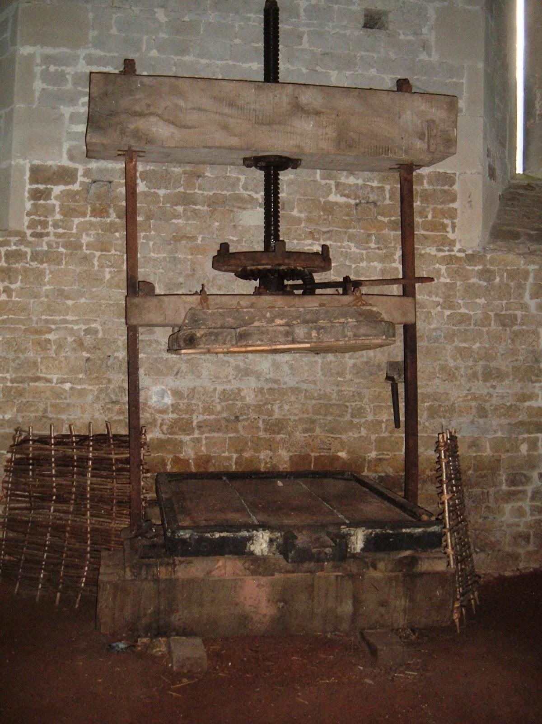
Crushing isn’t necessarily bad.
src: http://commons.wikimedia.org/wiki/File:Apple_press.JPG

Slide 22
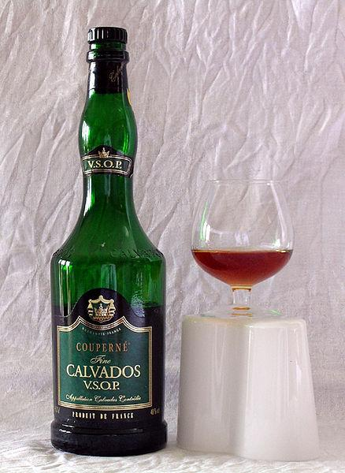
Crushing and distilling can be good
src: http://commons.wikimedia.org/wiki/File:Couperne_Calvados.jpg

Slide 23
Back to crushing good ideas...

Slide 24
Idea Guardian? No thanks...
Ideas have owners...
Idea owners wish to be recognised for their idea...
Idea owners may wish to preserve the purity of their vision...
Idea owners may not have skills to implement or realise their idea...

Slide 25
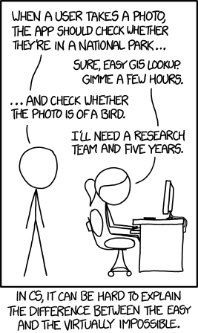
Bits of the idea may suck...
src: http://xkcd.com/1425/

Slide 26
So by “Crushing”
We capture the essence of an idea - a vector of opportunity and benefit
The idea becomes more “tweakable”
The idea can grow beyond it’s creator

Slide 27
fin -

Slide 28
Essential Reading
http://agilemanifesto.org/
http://www.mountaingoatsoftware.com/blog
http://www.romanpichler.com/blog/

Slide 29
More on...
steve@stevenpitchford.com
@stevejpitchford
www.stevenpitchford.com

